Slide 1







PROJECTS | PRODUCTS | COURSE | INTERNSHIP
info@discoverprojects.com
www.discoverprojects.com
pro.aiskool@gmail.com
www.aiskool.com
Shop no. 2, Narayan Smurti Building, Opp. Saraswati Book Depot,
Near CIDCO Bus Stop, Thane West, India.
+91 9967478289 / +91 9167769993

Slide 2


Market Basket Analysis
Relevant Image

Slide 3
Introduction and Application
The objective is to build a prediction engine for analysis of market basket using Apriori.

Slide 4
Working
FIRST STEP WAS TO COLLECT DATA FROM DIFFERENT SOURCES FOR OUR PROBLEM STATEMENT .
THEN WE HAVE TO CLEAN , PROCESS CATEGORICAL DATA AND NORMALISE IT.
THEN WE SHOW VARIOUS ANALYSIS USING GRAPHS.
SPLIT THE DATA INTO TRAINING AND TEST SET.
SELECT AN ALGORITHM.
FITTING THE MODEL TO TRAINING SET.
SAVING THE MODEL
CHECK ACCURACY OF TRAINED DATA W.R.T TRAIN SET.
TEST THE TRAINED MODEL W.R.T TESTING SET.
CHECK ACCURACY OF TEST DATA W.R.T TEST SET.
BASED ON THE GENERATED GRAPHS WE CAN ANALYSE MARKET BASKET.

Slide 5
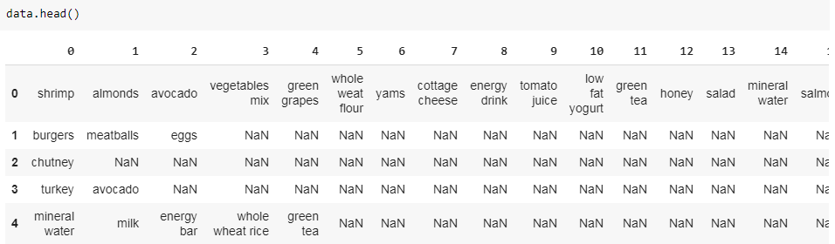
Working and Building
This is the data that we are using for the analysis of document clusters.

Slide 6
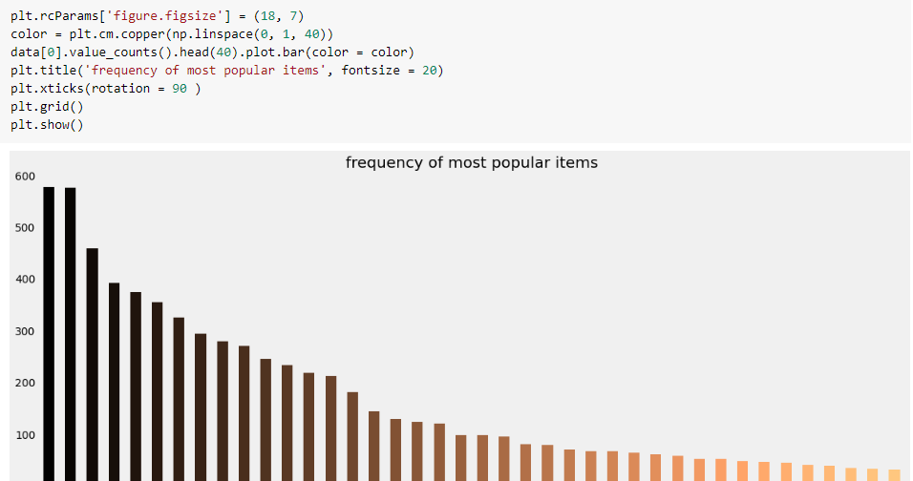
Working and Building
We have created a bar graph for the frequency of items.

Slide 7
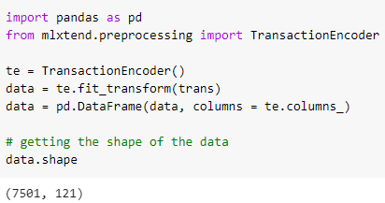
Handling Categorical Data
We have used Transaction Encoder for handling categorical data. Encodes database transaction data in form of a Python list of lists into a NumPy array.

Slide 8
Selecting Algorithm
We have used Apriori.
Apriori is an algorithm for frequent item set mining and association rule learning over relational databases. It proceeds by identifying the frequent individual items in the database and extending them to larger and larger item sets as long as those item sets appear sufficiently often in the database.

Slide 9
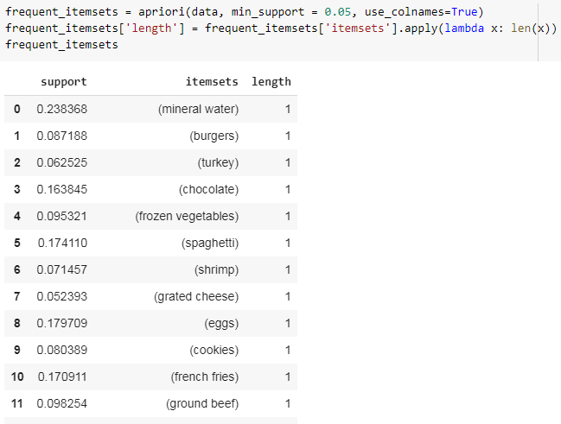
Selecting Algorithm
We are using an Apriori function to analyse the data.

Slide 10
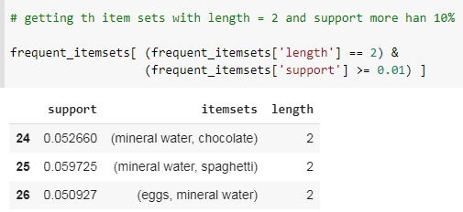
Results

Slide 11
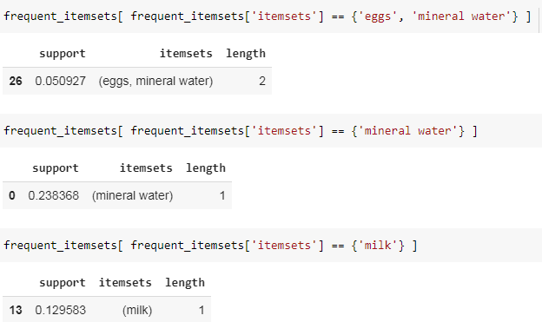
Mining
We are printing the support for each itemset.

Slide 12
FAQ
What is the use of read_csv()?
read_csv() is an important pandas function to read csv files and do operations on it.
2. What is the use of iloc?
iloc returns a Pandas Series when one row is selected, and a Pandas DataFrame when multiple rows are selected, or if any column in full is selected. To counter this, pass a single-valued list if you require DataFrame output.
3. What is Apriori principle?
The apriori principle can reduce the number of itemsets we need to examine. Put simply, the apriori principle states that. if an itemset is infrequent, then all its supersets must also be infrequent. This means that if {beer} was found to be infrequent, we can expect {beer, pizza} to be equally or even more infrequent.

Slide 13
FAQ
4. What is the difference between the RMSE and RMSLE method for measuring accuracy?
The value of the RMSE explodes in magnitude as soon as it encounters an outlier. In contrast, even on the introduction of the outlier, the RMSLE error is not affected much i.e. RMSLE is very robust when outliers come into play.
5. Can we use RMSLE method for measuring accuracy?
Yes, we can.

